Slide 1

EvoAstra Ventures pvt ltd
Mice Protein Expression Classification
-- Internship Project Report
Abhishek Gupta

Slide 2
Project Overview
  Multiclass classification of mice using brain protein expression data
  Dataset: 1080 samples, 82 features (77 proteins)
  Target: 8 experimental groups (based on genotype, treatment, behavior)
  Domain: Biomedical research (e.g., Down syndrome, drug effects)

Slide 3
Objective
  Classify mice into 8 experimental groups
  Understand which proteins contribute to group differences
  Enable biomedical insights through ML-based classification
  Model used: Random Forest + comparisons

Slide 4
Dataset Description
  Source: Data_Cortex.csv
  Rows: 1080 mice samples
  Features:
  77 Protein expression levels (continuous)
  5 categorical features: MouseID, Genotype, Treatment, Behavior, class
  Target: Class (e.g., c-CS-m, t-SC-s)

Slide 5
Sample Proteins
  DYRK1A_N: Down syndrome biomarker
  BDNF_N: Brain-derived neurotrophic factor
  GFAP_N: Glial activation
  APP_N: Alzheimer’s protein
  pAKT_N: Cell signaling marker

Slide 6
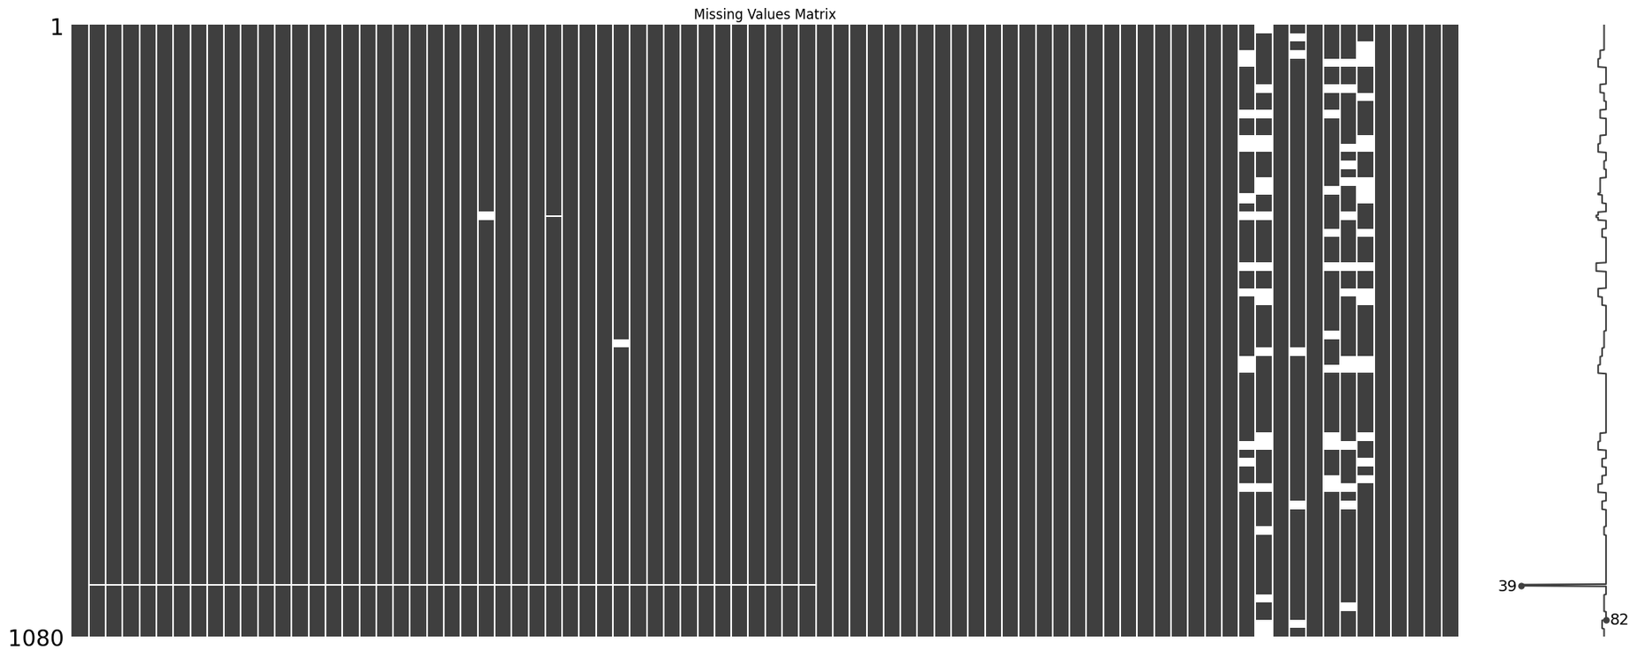
Data Preprocessing
  Missing values: Mean imputation
  Label encoding for categorical data
  Standardization applied to protein features
  No major class imbalance detected

Slide 7
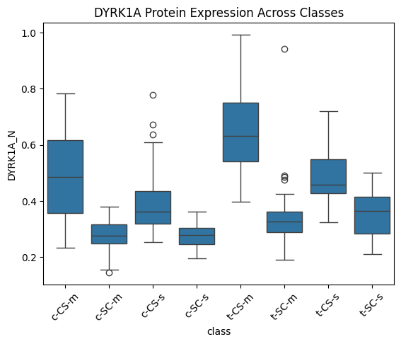
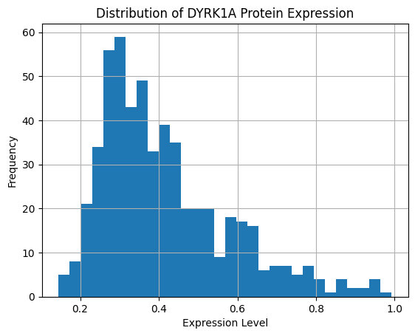
Exploratory Data Analysis
Distribution of protein values: Mostly normal
Boxplot insights: Class-specific expression variation (e.g., DYRK1A)

Slide 8
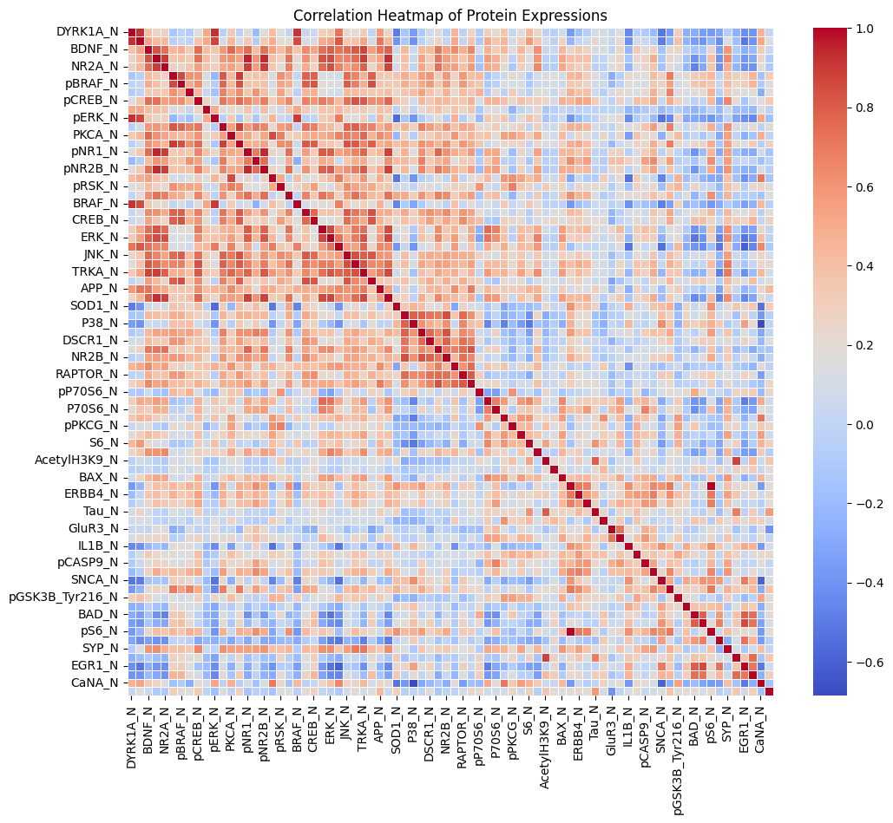
Correlation heatmap: Many proteins highly correlated

Slide 9
Modeling Approach
  Models Used:
  scikit-learn used for implementation
    Random Forest (best)
    SVM
    Logistic Regression
    KNN
  Train/test split: 80–20
  Hyperparameter tuning for Random Forest

Slide 10
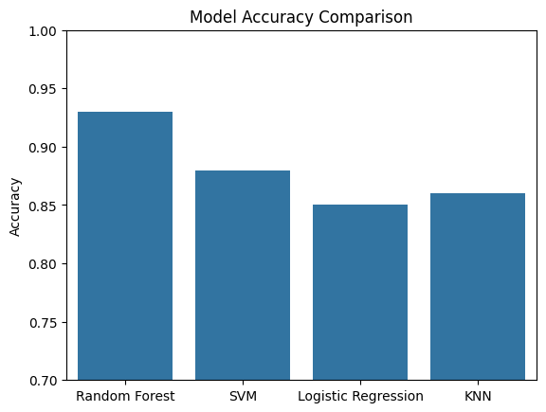
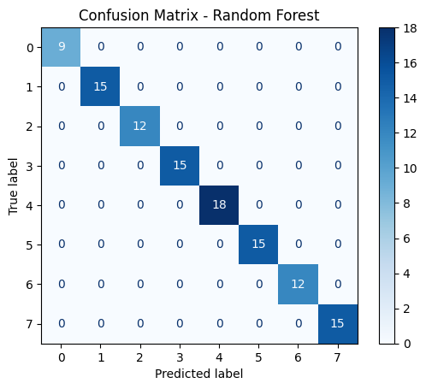
Model Evaluation
  Random Forest Accuracy: 93%
  Other Models:
    SVM: 88%
    KNN: 86%
    Logistic Regression: 85%
  Metrics: Accuracy, Precision, Recall, F1-Score

Slide 11
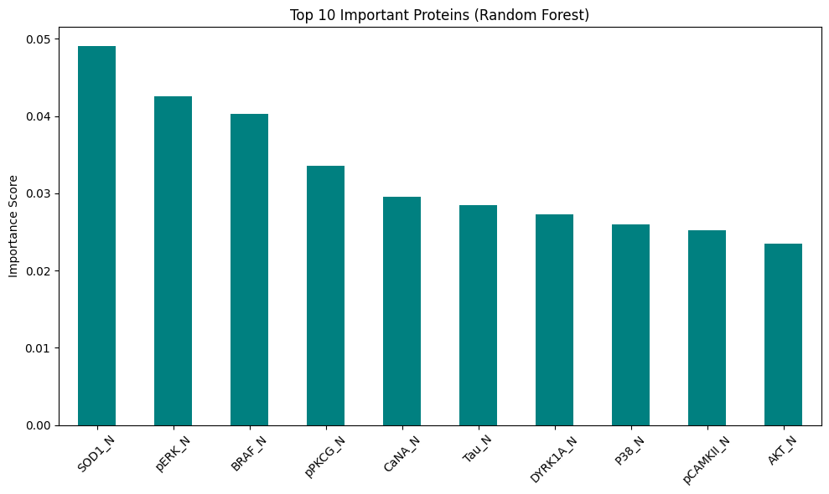
Feature Importance
  Top proteins influencing prediction:
    DYRK1A, BDNF, GFAP, APP
  Feature importance extracted from Random Forest
  Aligns with domain knowledge (e.g., Alzheimer’s & Down syndrome)
SOD1_N 0.049059
pERK_N 0.042561
BRAF_N 0.040231
pPKCG_N 0.033584
CaNA_N 0.029513
Tau_N 0.028471
DYRK1A_N 0.027245
P38_N 0.025977
pCAMKII_N 0.025186
AKT_N 0.023511

Slide 12
Challenges Faced
  🧬Handling missing values for multiple proteins
  📈High dimensionality of protein data
  🤔Interpretability of models for non-technical stakeholders
  Potential overlap among classes

Slide 13
Conclusion
  Machine Learning successfully classified mice into 8 experimental groups using protein expression data from the brain cortex.
  Random Forest Classifier delivered the best performance with ~93% accuracy.
  Feature importance analysis revealed biologically relevant proteins like:
    SOD1 (oxidative stress)
    DYRK1A (linked to Down syndrome)
    Tau (associated with Alzheimer’s)
  The project pipeline integrates:
    Data preprocessing
    Exploratory Data Analysis (EDA)
    Model training, evaluation, and interpretation

Slide 14
Future Scope
  🔍 Feature Optimization
  Apply PCA, Lasso Regression, or Recursive Feature Elimination (RFE) for dimensionality reduction and interpretability.
  🧠 Advanced Modeling
  Explore Deep Learning models (e.g., MLPs, CNNs) for learning complex, non-linear patterns in high-dimensional protein data.
  🧬 Dataset Expansion
  Extend the model to human protein datasets for translational research in Alzheimer’s, Down syndrome, etc.
  📊 Biological Insight
  Perform individual protein impact studies to understand their biological significance and validate with literature.

Slide 15

🙏
Kindly, Give some suggetion or feedback.
If you have any question, you can ask freely.
The End👋
abhishekgp20004@gmail.com

